Slide 1
Half-Life

Slide 2
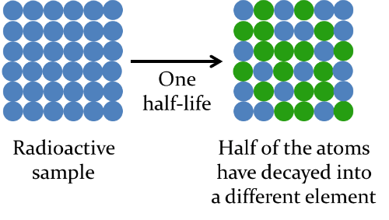
In this Smart Lesson you will learn to:
Define half-life.
Solve radioactive decay problems involving whole numbers of half-lives.

Slide 3
Half-life definition.
The half-life is the time taken for half of the atoms in a sample of the material to undergo radioactive decay.

Slide 4


Slide 5


We use the following formula when working with half-lives:
N_{0​} is the number of particles in the original sample of atoms.
n is the number of half-lives. This must always be a whole number - you can't have a quarter of a half-life!
Finally, N is the number of particles after n half-lives have occurred.

Slide 6
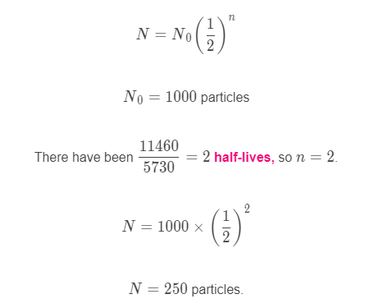
Worked example:
Carbon−14 has a half-life of 5730 years.
How many particles of C−14 will remain in a sample after 11,460 years have passed, if the initial sample contained 1000 particles?

Slide 7
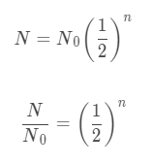
Calculating the number of half-lives.
We can also find the number of half-lives (n) which must have passed to produce a certain number of undecayed particles.
To do this we need to rearrange our half-life formula to make n the subject.

Slide 8
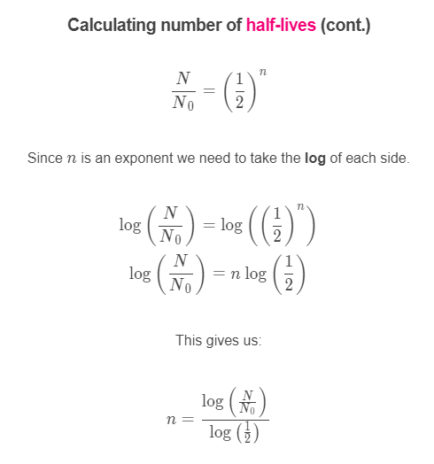

Slide 9
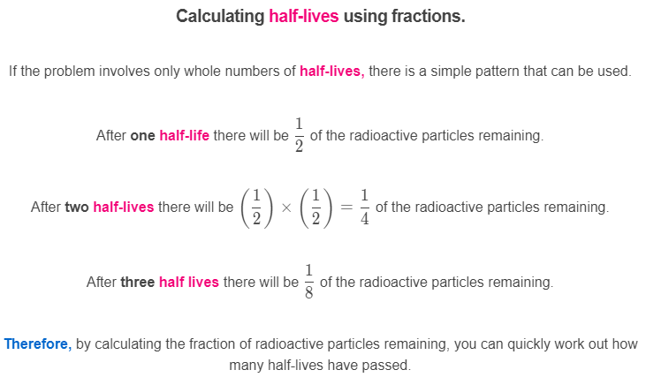

Slide 10
